Slide 1
Chapter 2: Introduction to Switched Networks
Routing and Switching
Notes:
Cisco Networking Academy program
Routing & Switching
Chapter 1: Introduction to Switched Networks

Slide 2
Chapter 1
1.0 Introduction
1.1 LAN Design
1.2 Switched Environment
1.3 Summary
Notes:
Chapter 1

Slide 3
Chapter 1: Objectives
Upon completion of this chapter, you will be able to:
Describe convergence of data, voice, and video in the context of switched networks.
Describe a switched network in a small-to-medium-sized business.
Explain the process of frame forwarding in a switched network.
Compare a collision domain to a broadcast domain.
Notes:
1.

Slide 4
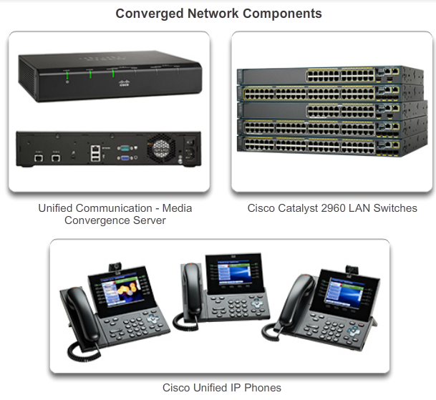
Converged Networks
Growing Complexity of Networks
Our digital world is changing.
Information must be accessed from anywhere in the world.
Networks must be secure, reliable, and highly available.
Notes:
1.1.1.1 Growing Complexity of Networks

Slide 5
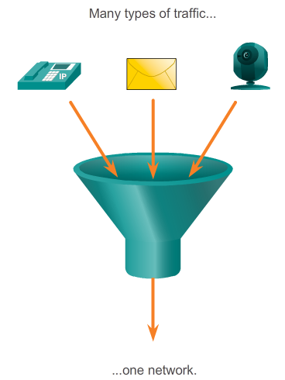
Converged Networks
A Converged Network
Collaboration is a modern requirement.
To support collaboration, networks employ converged solutions.
Qn: Define converged network.
__________________________________
__________________________________
Benefits of a converged network
  Only 1 network to manage
  Cost savings to install just 1 network
  Integrates IT management
A converged network combines voice,
video and data on 1 physical network.
Notes:
1.1.1.2 Elements Of A Converged Network

Slide 6
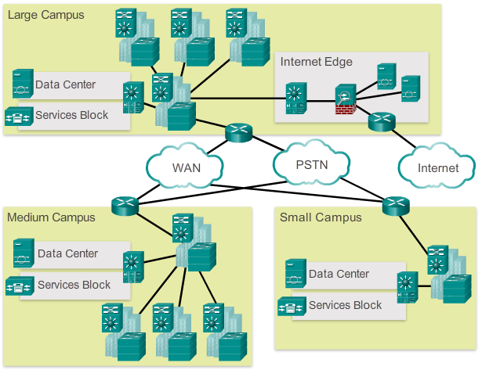
Converged Networks
Borderless Switched Networks
A well designed network architecture allows an organization to connect anyone, anywhere, anytime, on any device securely, reliably, and seamlessly.
An example is the Cisco Borderless Network which provides a framework to unify wired and wireless access, with policy and control across different device types.
Notes:
1.1.1.3 Borderless Switched Networks

Slide 7
Converged Networks
Hierarchy in the Borderless Switched Network
Network design guidelines are built upon the principles:
  Hierarchical – tiered layers to simplify deployment, management and reducing fault domains at each tier
  Modularity – allows seamless expansion
  Resiliency – network is always on
  Flexibility – allows intelligent load sharing using all resources
Notes:
1.1.1.4 Hierarchy in the Borderless Switched Network

Slide 8
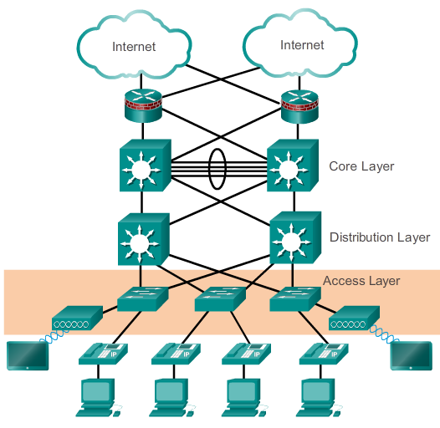
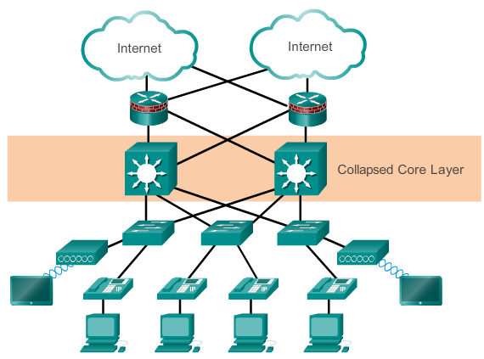
Converged Networks
Hierarchy in the Borderless Switched Network
3-tiered LAN Design
2-tiered LAN Design which collapses core and distribution layers together
Notes:
1.1.1.4 Hierarchy in the Borderless Switched Network

Slide 9
Converged Networks - Core, Distribution, Access Layers
Access layer
  The network edge where traffic enters / exits the network
  Provides network access to the user
  Connected to distribution layer switches
Distribution layer
  Interface between access and core layer
  Aggregates large-scale wiring closet networks
  Aggregates Layer 2 broadcast domains and Layer 3 routing boundaries
  Provides intelligent switching, routing and network access policy functions
  Provides high-availability through redundant paths
Core layer
  The network backbone
  Provides fault isolation and high-speed backbone connectivity
Notes:
1.1.1.5 Core, Distribution, Access

Slide 10
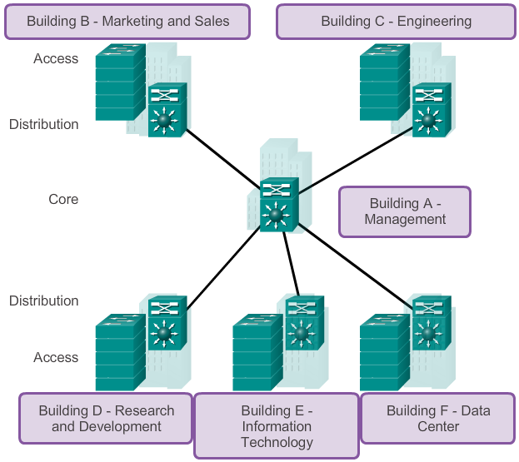
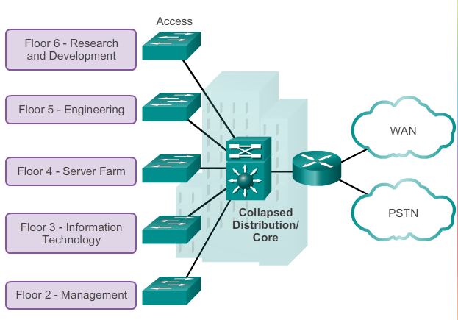
Converged Networks
Core, Distribution, Access Layers
What type of LAN design are these?
Notes:
1.1.1.5 Core, Distribution, Access

Slide 11
Converged Networks
Core, Distribution, Access Layers
Which layer do these functions belong to?
Function | Core | Distribution | Access
Supports Layer 2 broadcast domains and Layer 3 routing boundaries
Provides direct, switched network connectivity to users
Helps applications operate on the switched network safely and securely
Includes redundancy as an important feature for switched network access
A collapsed design combines this Layer with the Distribution Layer
Provides fault isolation and high-speed backbone switch connectivity
●
●
●
●
●
●
Answers in NetAcad Chapter 1.1.1.6 Activity
Notes:
1.1.1.5 Core, Distribution, Access

Slide 12
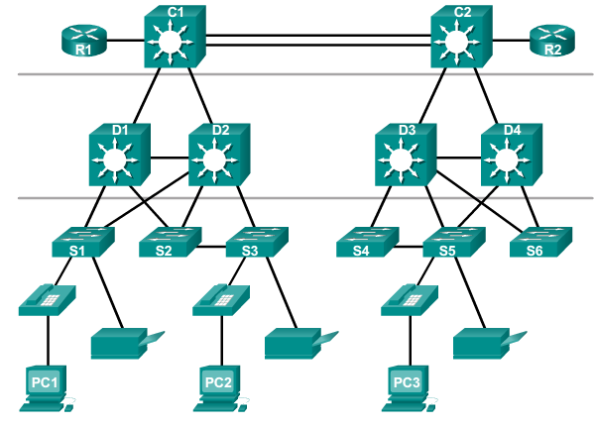
Switched Networks
Role of Switched Networks
Switching technologies are crucial to network design.
Switching allow traffic to be sent only where it is needed in most cases, using fast methods.
A switched LAN:
  Allows more flexibility to connect end devices
  Allows better traffic management
  Supports features like:-
    quality of service (QoS)
    security
    wireless networking
    IP telephony
    mobility services
Notes:
1.1.2.1 Role of Switched Networks

Slide 13
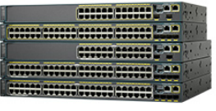
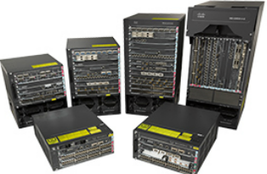
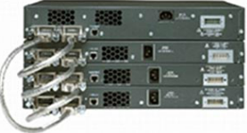
Switched Networks
Form Factor
Fixed Configuration Switches
Features / options are limited to what is available for that switch
Modular Configuration Switches
Begins with a chassis for installation of multiple modular line cards
Stackable Configuration Switches
Interconnected using a special cable for high-bandwidth throughput between the switches.
Notes:
1.1.2.2 Form Factor

Slide 14
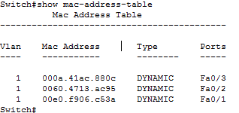
Frame Forwarding
Dynamically Populating a Switch MAC Address Table
Frame forwarding refers to the process where a switch transmits a frame from an ingress port (incoming) through an egress port (leaving)
A switch must first learn which device exists on each port before it can transmit a frame.
It maintains a MAC address table which maps the MAC address of a connected device to the Port number on the switch:
Notes:
1.2.1.2 Dynamically Populating a Switch MAC Address Table

Slide 15
Frame Forwarding
Dynamically Populating a Switch MAC Address Table
Switches learn MAC addresses
from incoming frames
When the switch receives a frame on a port, it examines the source MAC address and compares it to the MAC address table.
  If the MAC address is not in the table, it maps the source MAC address to the ingress port and adds it to the MAC address table.
  If the MAC address table already has an entry for that source MAC, it resets the aging timer. An entry is typically kept for five minutes.
After the switch has recorded the source address information, the switch examines the destination MAC address.
  If the destination address is not in the table or if its a broadcast address, (as indicated by all “F”), the switch floods the frame to all other ports.
  If the destination address is in the table, it forwards the frame through the mapped port for that address.
Notes:
1.2.1.2 Dynamically Populating a Switch MAC Address Table

Slide 16
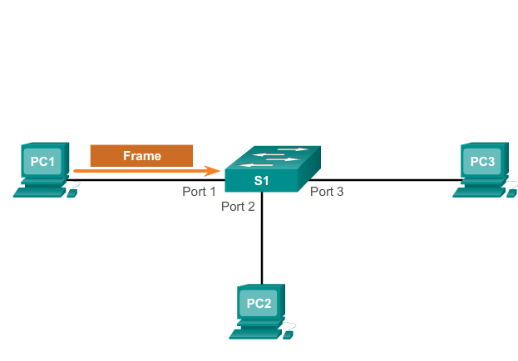
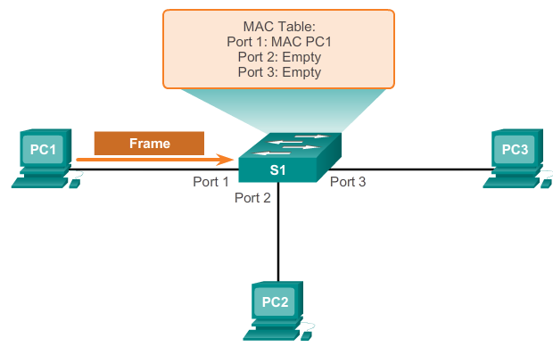
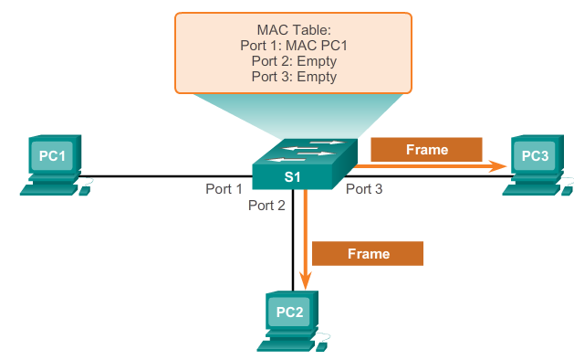
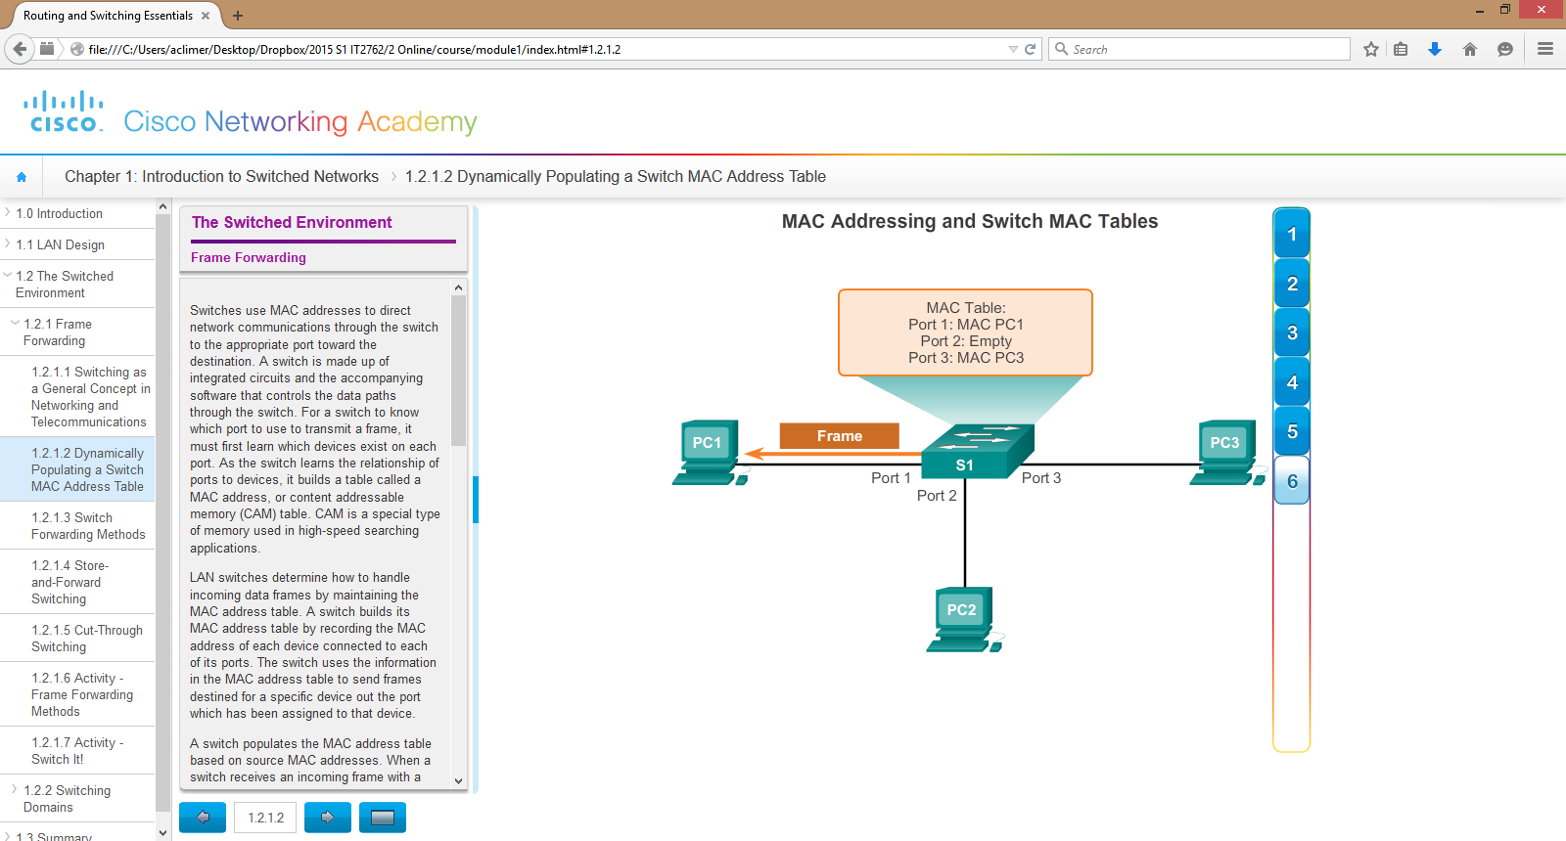
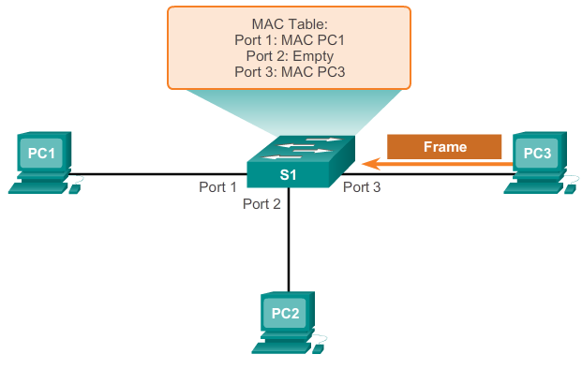

Frame Forwarding
Dynamically Populating a Switch MAC Address Table
See NetAcad 1.2.1.2 for above illustration
Notes:
1.2.1.2 Dynamically Populating a Switch MAC Address Table

Slide 17
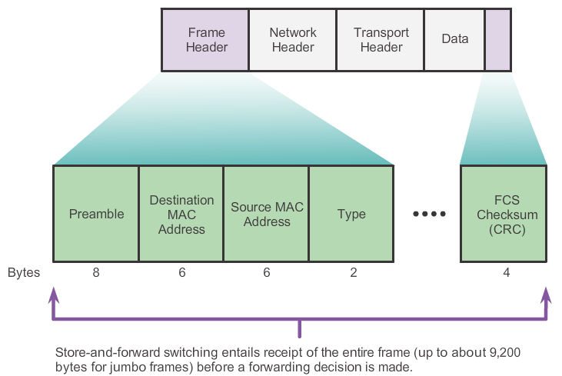
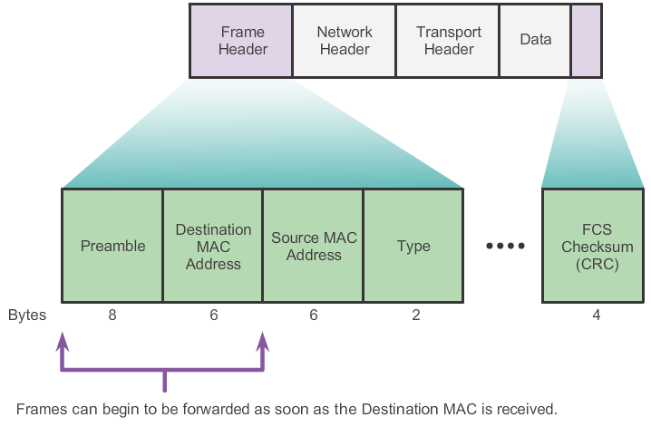
Frame Forwarding
Switch Forwarding Methods
Switches generally use 2 types of forwarding methods:-
Store-and-Forward
  Receives the entire frame
  Computes and compare the Frame Check Sequence (FCS) for error
  Drop if frame is damaged otherwise forward it out
Cut-Through
  Forwards the frame before it is entirely received
  Minimally the destination address is read before forwarding
Notes:
1.2.1.3 Switch Forwarding Methods

Slide 18
Frame Forwarding
Switch Forwarding Methods
Store-and-Forward method
    Check for errors (via FCS check)
    Perform automatic buffering
    But slower
Cut-Through forwarding method
    Very fast. Allows the switch to start forwarding in about 10 microseconds
    But no FCS check and no automatic buffering
  See NetAcad 1.2.1.6 for activity learning
Notes:
1.2.1.4 Store-and-Forward Switching

Slide 19

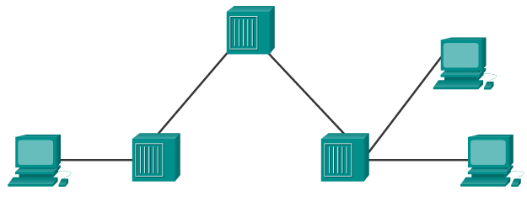

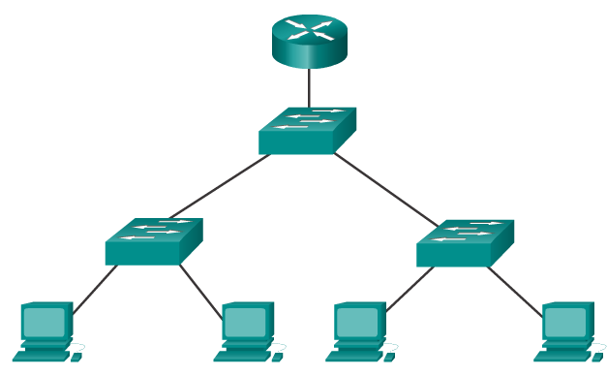
Switching Domains
Collision Domains
A collision domain is the network segment where devices must compete to communicate.
Before the modern switch, a hub was used to connect end-devices together. All ports of a hub belong to 1 collision domain.
With the switch, each port is a collision domain.
A switch breaks a network into many smaller collision domains
More bandwidth for devices
Collisions in 1 segment do not affect the other segments
“microsegmentation”
How many collision domains are there?
Notes:
1.2.2.1 Collision Domains

Slide 20
Collision Domains
https://www.youtube.com/watch?v=_c1gqcr6Lcs

Slide 21
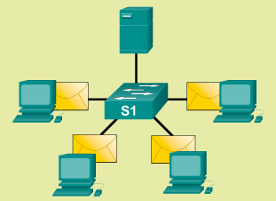
Switching Domains
Broadcast Domains
A broadcast domain is the extend of the network where a broadcast frame can be heard.
A frame with destination MAC address of all “F” is a broadcast frame (FFFF.FFFF.FFFF)
A switch forwards broadcast frames to all ports except the port where the broadcast frame came from.
All ports of a switch (by default configuration), belong to the same broadcast domain.
Broadcast frame sent
Notes:
1.2.2.2 Broadcast Domains

Slide 22
Broadcast Domains
https://www.youtube.com/watch?v=s3pq0bdZMz8

Slide 23
Switching Domains
Alleviating Network Congestion
Switches help alleviate network congestion by:
Segmenting a LAN into separate collision domains
Providing full-duplex communication between devices
Taking advantage of their high-port density
Buffering large frames
Employing high-speed ports
Taking advantage of their fast internal switching process
Having a low, per-port cost
Notes:
1.2.2.4 Alleviating Network Congestion

Slide 24
Chapter 2: Summary
In this chapter, you learned:
The trend in networks is towards convergence using a single set of wires and devices to handle voice, video, and data transmission.
There are no more constraints due to physical offices or geographic boundaries. Resources must now be seamlessly available anytime and anywhere.
A well-designed borderless network architecture enables different elements, from access switches to wireless access points, to work together and allow users to access resources from any place at any time.
Notes:
Chapter 1 Summary

Slide 25
Chapter 2: Summary (cont.)
The three-layer hierarchical design model divides the network into core, distribution, and access layers, and allows each portion of the network to be optimized for specific functionality.
It provides modularity, resiliency, and flexibility, which provides a foundation that allows network designers to overlay security, mobility, and unified communication features.
Switches use either store-and-forward or cut-through switching.
Every port on a switch forms a separate collision domain allowing for extremely high-speed, full-duplex communication.
Switch ports do not block broadcasts and connecting switches can extend the size of the broadcast domain, but may cause degraded network performance.
Notes:
Chapter 1 Summary

